Slide 1
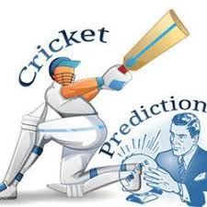
Cricket Game Predictor
Group: salman Karim | Muhammad mohsion
machine Learning

Slide 2
Outline
Introduction
Methodology
Features
Data Collection
Results

Slide 3
Introduction
Cricket is the second most popular sports in the world.
Most popular could mean most watched, most played or most revenue-generating sports.
We designed a system which predicts the outcome of a match before its been played based on historical data.

Slide 4
Methodology
We created machine learning models with a specific end goal to anticipate results of the cricket match. We utilized a multi-step way to deal with examine the information that deliver different features.
Logistic Regression
Random forests
Naïve Bayes
SVM
Decision Tree Classifier
Neural Network (new)
Nearest Neighbors (new)

Slide 5
Data Collection
Data is collected form cricsheet.org
Cricsheet provide ball-by-ball data including information of bowler, date, city, gender, outcomes, wickets, runs, umpires, toss decision, teams, innings, wickets for men’s and women’s Test Matches, One Day Internationals and t20 matches.
Extracted the features form yaml files and stored in CSV files.

Slide 6
Features
Database consists of following data:
Date
City
Team_1
Team_2
Toss Winner
Toss Decision
Result
Winner
Win-by-Runs
Win-by-Wickets
Player of the Match
Venue

Slide 7
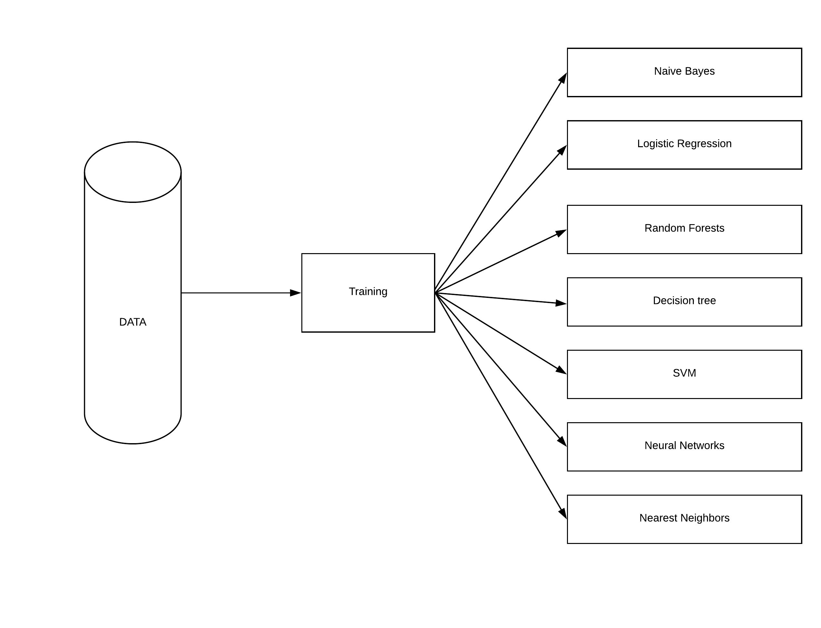
Implementation(1/2)
We used 70% of our data for training.
We used use multiple models so that we can improve our prediction
Models for training our data set:
Naïve Bayes
Logistic regression
Random Forests
Decision Trees
SVM
Nearest Neighbors
Neural Networks

Slide 8
Results
Algorithm | Accuracy
Naïve Bayes | 47.581%
Logistic regression | 33.871%
Random Forests | 93.93 %
SVM | 63.78%
Decision Tree Classifier | 88.70%
Neural Network | 50.38%
Nearest Neighbors | 23.056%

Slide 9
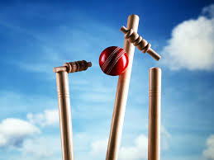
Question & Answers

